Slide 1
IOT Analysis

Slide 2
IoT
The Internet of Things (IoT) refers to a system of interrelated, internet-connected objects that are able to collect and transfer data over a wireless network without human intervention.

Slide 3
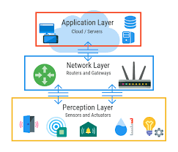
IoT architecture

Slide 4
Sensor
A sensor is a device that receives a stimulus and responds with an electrical signal

Slide 5
Problem Statement
Analysis of Temperature, Pressure, Humidity, Dust throughout the day for farming activities.
Tools: Python EDA
Source: Kaggle Data (Data taken from sensors)

Slide 6
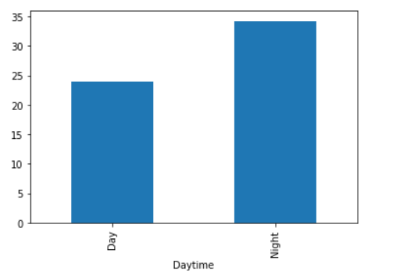
Day/Night vs Humidity
Humidity is more in night

Slide 7
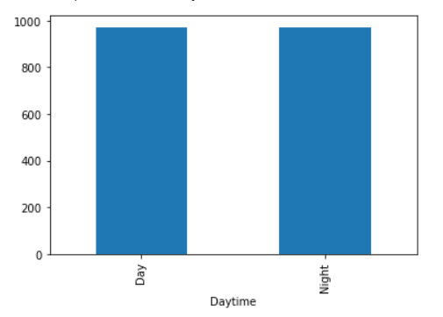
Day/Night vs Pressure
Pressure is equal both during day and night

Slide 8
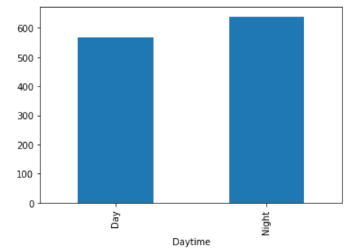
Day/Night vs Co2 Gas
Co2 Gas emission is more during time

Slide 9
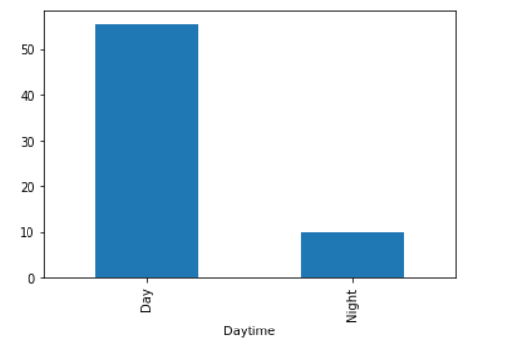
Day/Night vs Dust Particles
Dust Particles are more during the daytime in atmosphere

Slide 10
Inference
During daytime fields may be watered at periodical intervals based on moisture sensor data
So unnecessary wastage of power and water is minimized.

